Slide 1

CLYK
Presented by: Cherish | Loresa | Yesha | Kun
Notes:
341112137888476

Slide 2
TEAM MEMBERS
Cherish - Project Manager
Loresa - Database Manager and Backend Developer
Yesha - Frontend Developer and Designer
Kun - Git Manager and Server Handler
Notes:
341112137888476

Slide 3

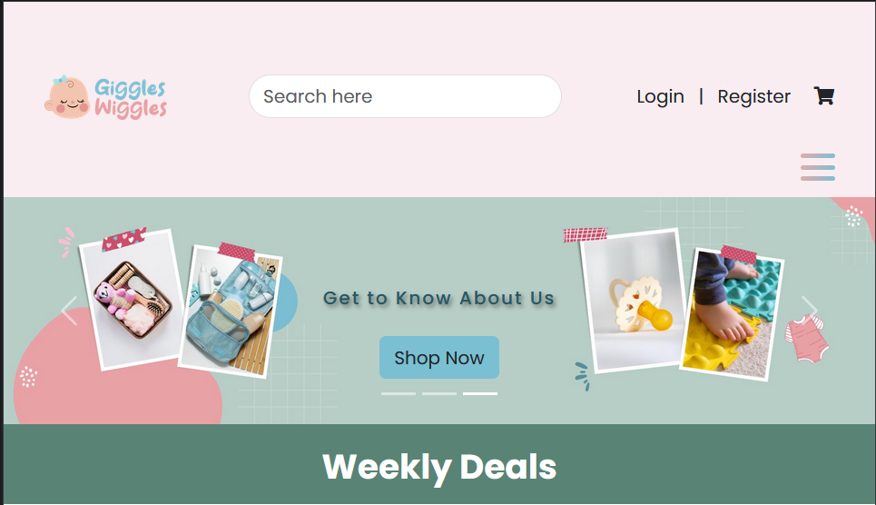

OVERVIEW
Introduction
Workflow
Key Features
Technology
Tools
Frontend
Backend - Dashboard
CRUD
Unique Value added

Slide 4
INTRODUCTION
Welcome to Giggles Wiggles, a dedicated space designed to cater to the needs of both new and experienced parents, offering a wide range of high-quality and essential products for all the little ones. Our mission is to make parenting easier, more enjoyable, and stress-free by providing a one-stop-shop for all the baby-related needs.

Slide 5
MAIN CATEGORIES
Apparel
Furniture
Toys
Bedding
Bathing
Gear

Slide 6








WORKFLOW
BRAINSTORMING
PLANNING
DESIGN
CODING
BACKEND
FRONTEND
DATABASE
CONVERT

Slide 7
KEY FEATURES
Extensive Product Range
User-Friendly Interface
Weekly Deals
Responsive Design
Secure Payment Gateway
Personalized Registries

Slide 8






TECHNOLOGY
FRONT END
BACK END
STYLING
FRAMEWORK

Slide 9




TOOLS

Slide 10

SITEMAP - FRONTEND
Giggles Wiggles Front-end Sitemap
Group : CLYK (Team 3)
Date : Dec 5, 2023
Search
Register
Login
Profile
Logout
Cart
Checkout
Home
Apparel
Furniture
Toys
Bedding
Bathing
Gear
Profile
List
View
List
View
List
View
List
View
List
View
List
View
My
Orders
Details
Page
Details
Page
Details
Page
Details
Page
Details
Page
Details
Page
Ratings
Gift
Registry
LEGEND
Home
About Us
Contact
Utility Navigation
Product List
Utility Nav Authenticated
Utility Nav Unauthenticated
Main Navigation
Footer Navigation
Secondary

Slide 11
SITEMAP - BACKEND
Giggles Wiggles Back-end Sitemap
Group : CLYK (Team 3)
Date : Dec 5, 2023
Admin
Customers
Categories
Brands
Line
Items
Orders
Products
Tax
Rates
Add
Add
Add
View
View
Add
Add
View
View
View
Update
View
View
Update
Update
Update
Update
Update
Delete
Delete
Delete
Delete
Delete

Slide 12
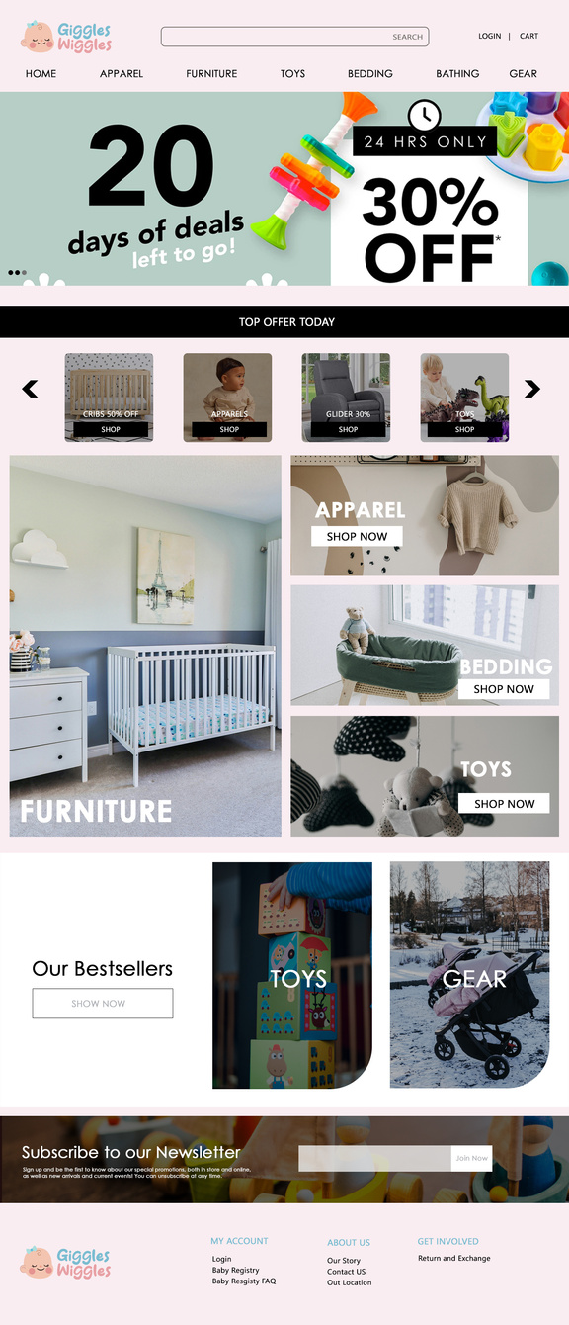



PROPOSED DESIGN
Here are the proposed PSD files for the design of home page, list view and detail view.

Slide 13
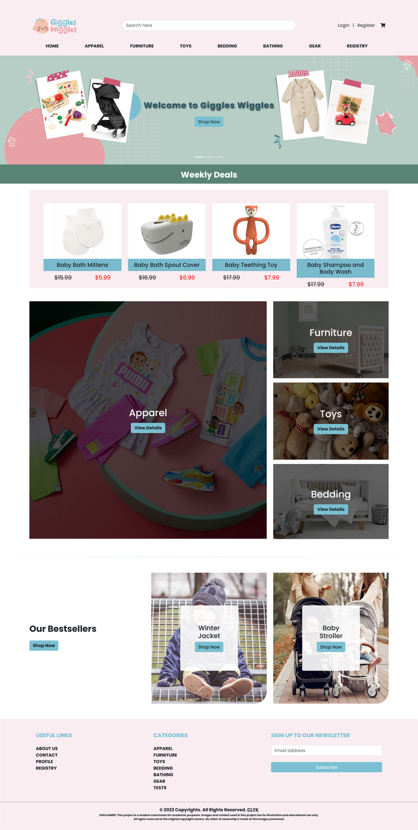
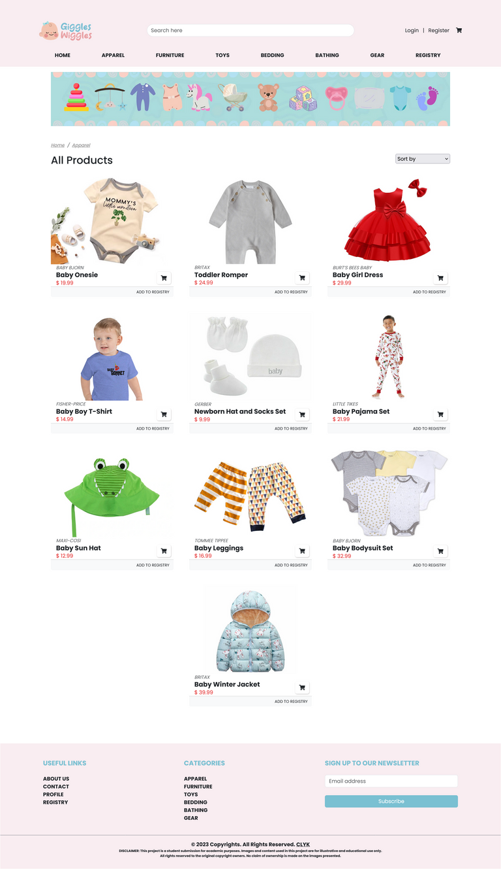

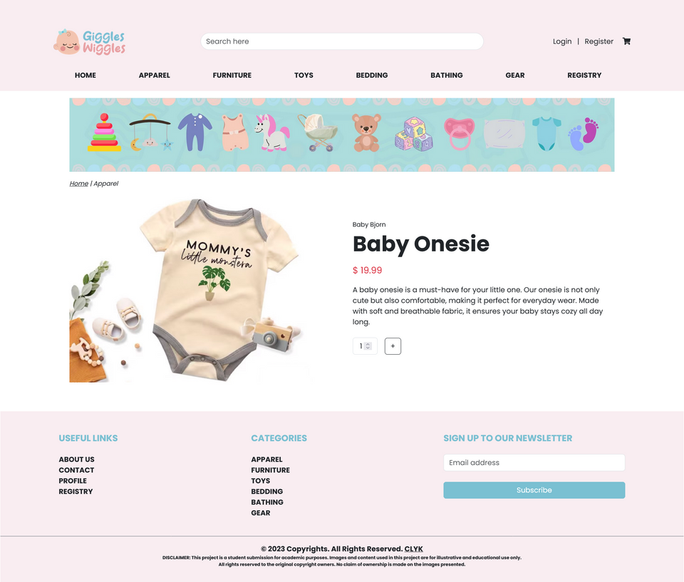
FRONTEND
Here are few frontend pages showing the home, list view and detail view

Slide 14
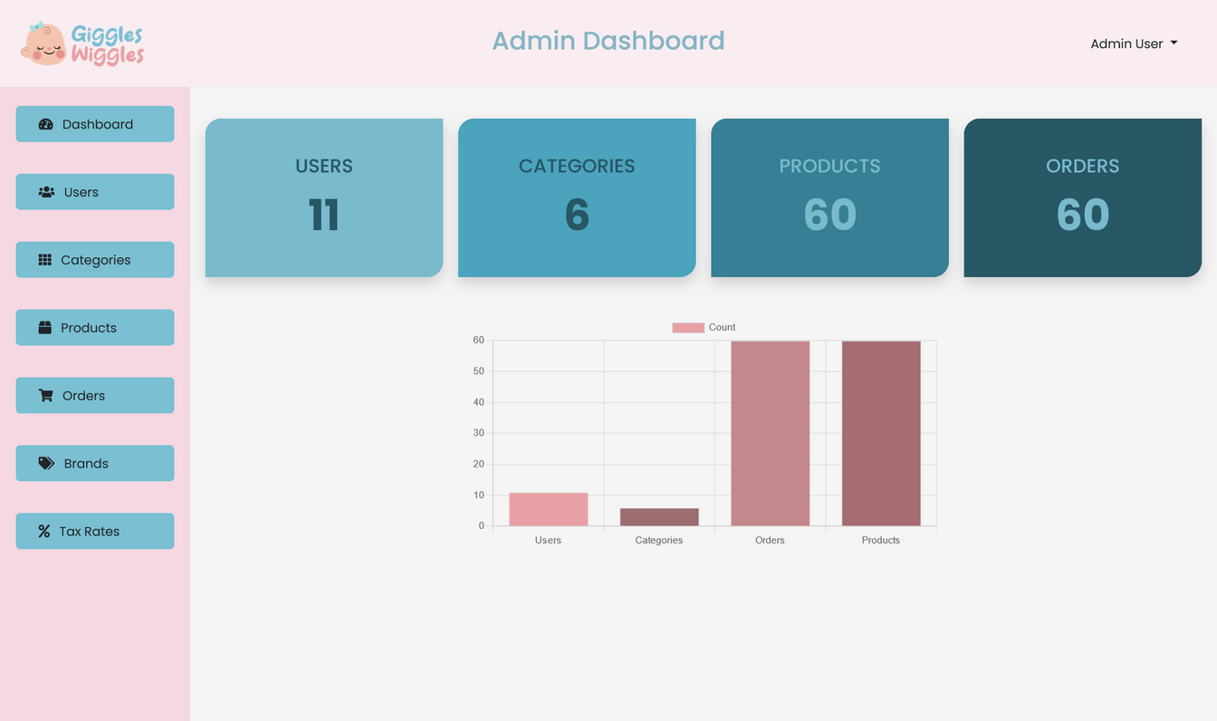
BACKEND
This is the dashboard showing the statistics.

Slide 15
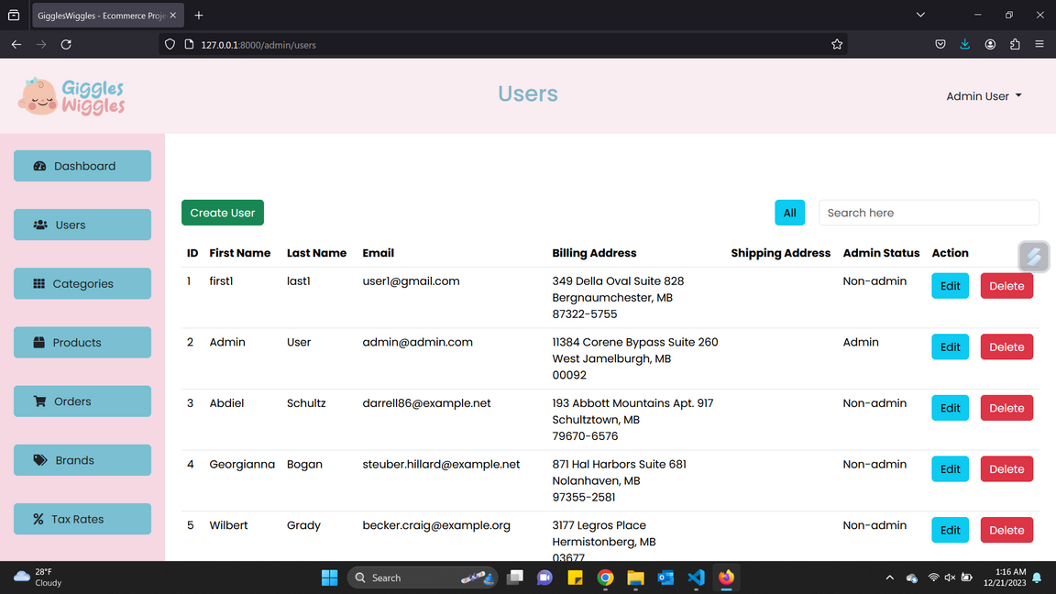
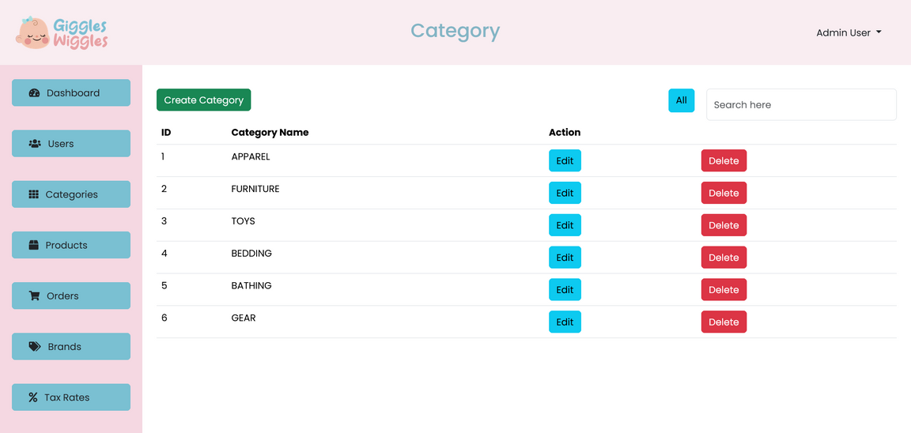
CRUD
Here are few backend pages showing the CRUD

Slide 16
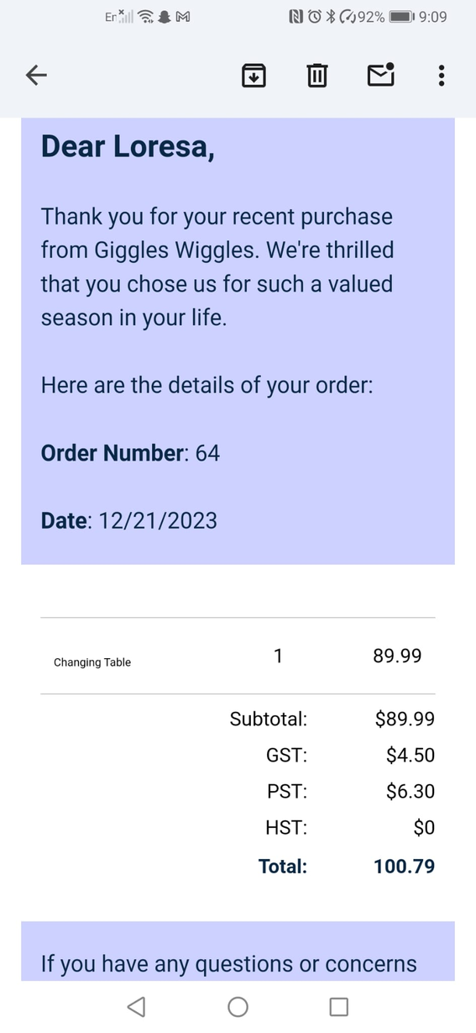
ORDER EMAIL
The user will receive an email after placing an order

Slide 17
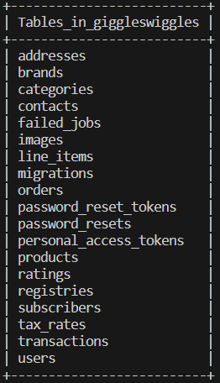
DATABASE TABLES

Slide 18
THANK YOU

